Slide 1
VAXTRACK V1
The Build Journey — Beta to v1.3.0
Four releases. One evolving vaccination platform.
v1.0.0
v1.1.0
v1.2.0
v1.3.0
Vivek Kumar | Associate Consultant, Infosys — Developer, British Petroleum

Slide 2
AGENDA
1
The Story So Far
7
v1.3.0 — Remastered Final: Polish & Support
2
Application Overview
8
Bugs Identified & Fixed
3
Release Timeline
9
Roles, Database & Architecture Evolution
4
v1.0.0 — Beta: What Shipped
10
Leftovers & Engineering Lessons
5
v1.1.0 — Remastered: Structural Rebuild
11
Conclusion — The Bridge to v2
6
v1.2.0 — Feature Completion
VaxTrack V1 — Build Journey

Slide 3
THE STORY SO FAR
The COVID-19 pandemic exposed how fragile ad-hoc vaccination logistics can be. VaxTrack started as a focused response: a web portal where a normal user could register, book a vaccination slot, and track their status — and an administrator could approve bookings and manage slot availability, all through one accountable system instead of scattered spreadsheets and phone calls.
4
releases in ~12 months
What followed wasn’t a single build — it was four releases across roughly a year, each one addressing what the last one got wrong or left out.
2
user roles served throughout
1
consistent vision, refined every release
VaxTrack V1 — Build Journey

Slide 4
APPLICATION OVERVIEW
Two roles, one loop — held constant across all four releases.
1
2
3
4
Register & Log In
Book a Slot
Admin Reviews
Approve & Track
→
→
→
New users register and are auto-logged in, landing on their profile.
Users browse available hospital slots and book a vaccination dose.
Administrators see every pending booking on a central dashboard.
Status flips from ‘not vaccinated’ to ‘vaccinated’ once approved — visible to both sides.
Stack at launch: ASP.NET MVC · Entity Framework Core · SQLite · ASP.NET Identity for auth
VaxTrack V1 — Build Journey

Slide 5
RELEASE TIMELINE
v1.0.0
v1.1.0
v1.2.0
v1.3.0
BETA
REMASTERED
FEATURE COMPLETION
REMASTERED FINAL
Foundation — core MVC app, 2 roles, SQLite.
Structural rebuild — DTOs, normalized data, new UI.
Profile edit + Slot Booking v2 modules.
Support module, password reset, full UI polish.
→
→
→
v1.2.0 shipped as a focused feature drop with no standalone review deck — its updates are folded into the v1.3.0 retrospective on the following slides.

Slide 6
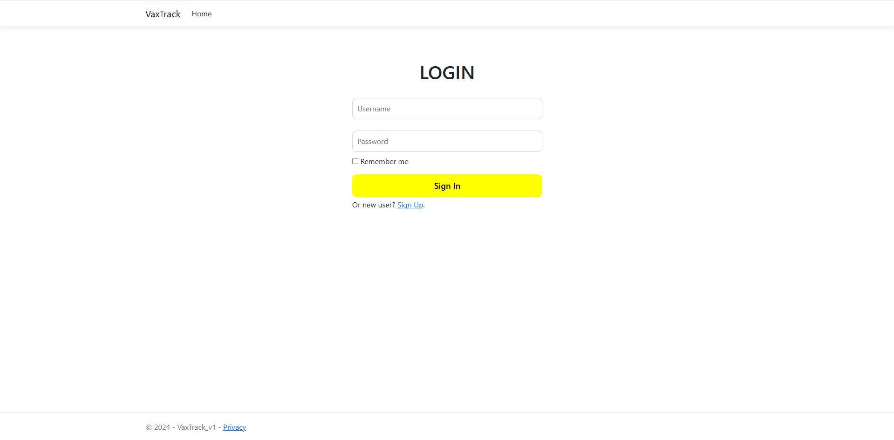
v1.0.0 — BETA: WHAT SHIPPED
Foundation release · ~Q4 2024
Built on ASP.NET MVC with server-rendered Razor views — the classic controller-per-page pattern.
Two roles from day one: normal user and administrator, each with a dedicated view set.
SQLite database via Entity Framework Core — lightweight, zero-install persistence for a demo-scoped build.
ASP.NET Identity handled authentication out of the box, including the IdentityUser base for login.
Core loop worked end to end: register → book a slot → admin approves → status updates.
v1.0.0 — Login page (Bootstrap defaults, minimal styling)
VaxTrack V1 — Build Journey

Slide 7
v1.0.0 — ARCHITECTURE AT LAUNCH
A straightforward three-layer MVC stack — no DTOs, models bound directly to views.
Presentation
Views + Controllers
Account, Profile, Booking, Admin, Home
↓
Business Logic
Services
Account, Profile, Booking, Admin, Vaccination, Hospital
↓
Data Access
EF Core + AppDbContext
Direct entity models — no DTO layer yet
↓
Database
SQLite
User, Vaccination, Booking, Hospital tables
VaxTrack V1 — Build Journey

Slide 8
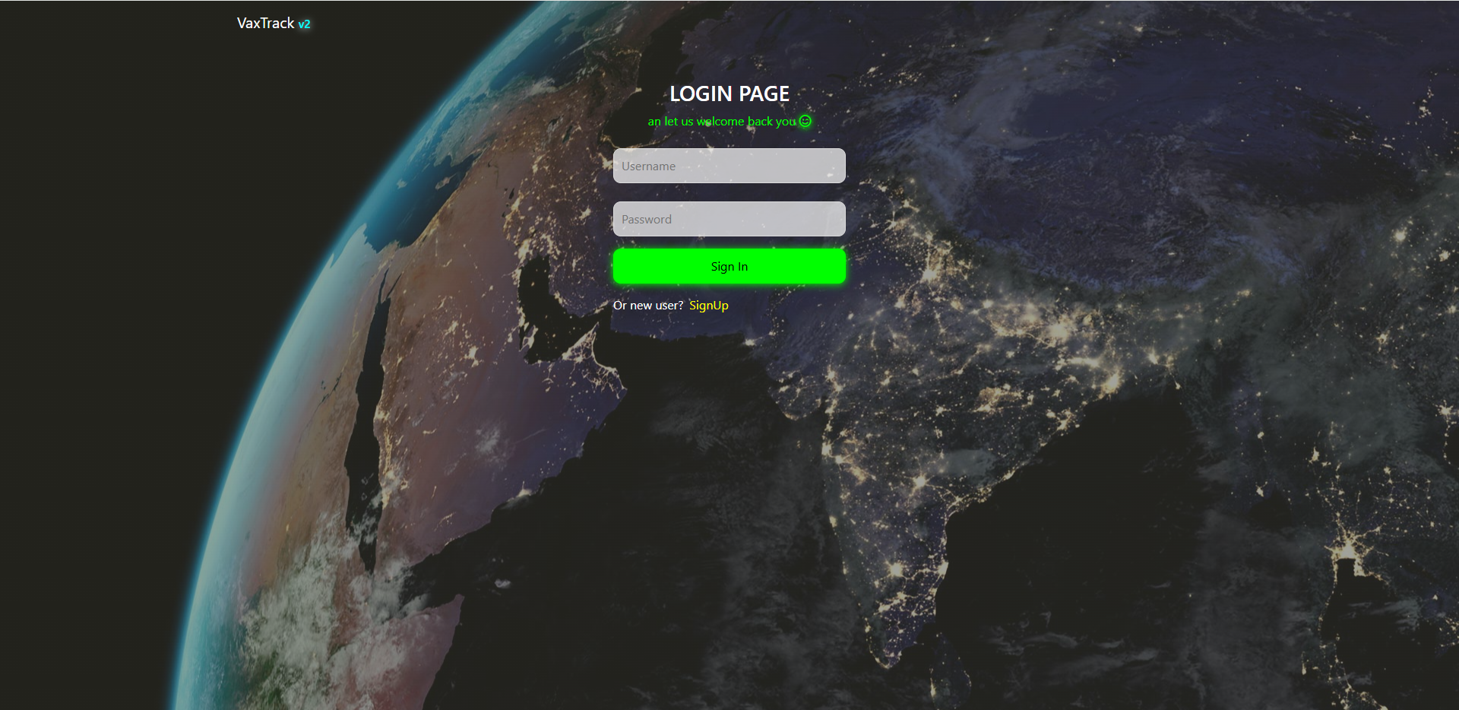
v1.1.0 — REMASTERED: STRUCTURAL REBUILD
No new features — this release paid down the architecture debt from Beta.
Restructured the application architecture end to end.
Added a missing DTO layer to decouple views from entity models.
Normalized and restructured model relationships (previously flat/unnormalized).
Removed the password column from the database, adopting ASP.NET IdentityUser properly.
Redefined service methods to match the new model structure.
Redesigned the admin page with additional charts for better insight.
BEFORE — v1.0.0 LOGIN
AFTER — v1.1.0 LOGIN
VaxTrack V1 — Build Journey

Slide 9
v1.2.0 — FEATURE COMPLETION
No dedicated review deck exists for this release — captured here from the engineering changelog.
✓
User Profile Edit Module
✓
Slot Booking V2 Module
Completed — users can update their own profile details in place.
Completed — reworked booking flow replacing the v1.0.0 implementation.
✓
Contextual Messaging
✓
Profile Picture Upload
Welcome / update / alert messages added across login, registration, profile edit, and booking.
Both users and admins gained the ability to upload a profile picture.
VaxTrack V1 — Build Journey

Slide 10
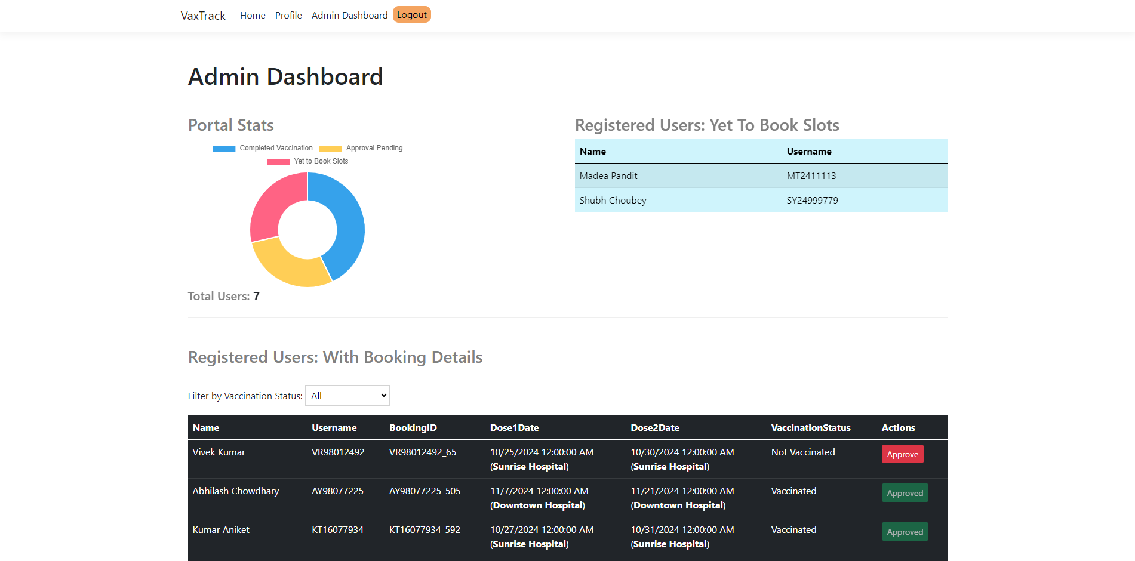
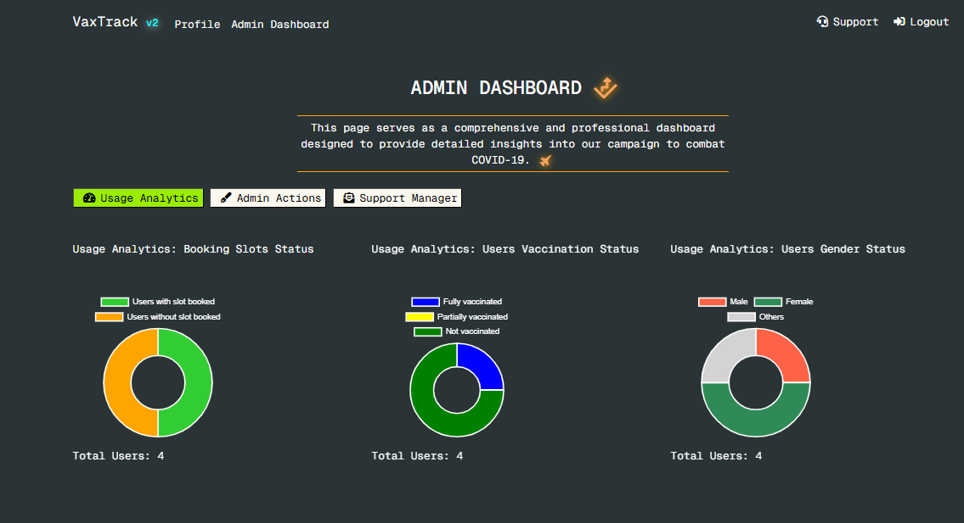
v1.3.0 — REMASTERED FINAL: NEW MODULES
The most feature-dense release — four new capabilities on top of a fully reworked UI.
Profile picture upload — completed and shipped.
Password reset feature — self-service reset flow added.
Support module — users can raise tickets and add follow-up comments.
Support management module — admins can update, modify, and close tickets — partially completed (file/media upload and status tracking left for a future release).
BEFORE — v1.0.0 ADMIN DASHBOARD
AFTER — v1.3.0 ADMIN DASHBOARD
VaxTrack V1 — Build Journey

Slide 11
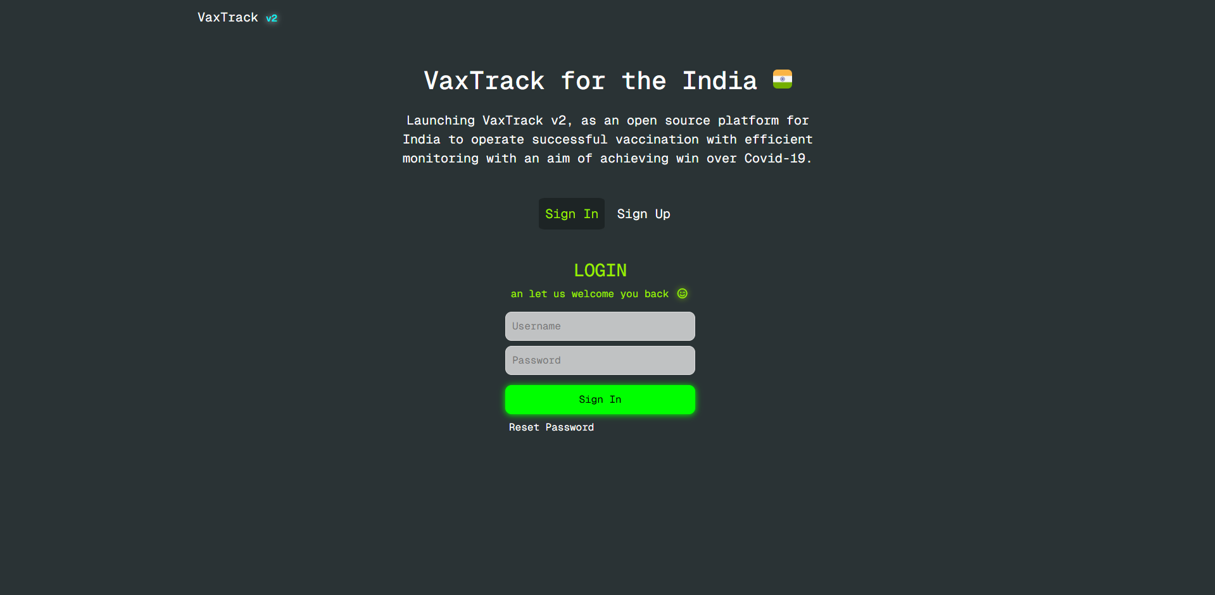
v1.3.0 — UI OVERHAUL & CONSOLIDATION
Every page was redesigned, and four standalone pages were folded into partial views on Home.
UI redesigned for Home, Sign In, Sign Up, User Profile, Edit Profile, Slot Booking, and Admin — plus suitable icons added throughout.
Removed the independent login, registration, profile-edit, and slot-booking pages.
Added partial login, registration, and password-reset views directly on the Home page.
Slot booking moved into a modal on the user profile page.
Built a v2 admin page with separate tabs (Usage Analytics, Admin Actions, Support Manager) for cleaner separation of concerns.
Replaced browser alert() calls with toast messages, and did a full CSS cleanup pass.
v1.3.0 — Home page, now hosting login, registration, and password reset as partial views
VaxTrack V1 — Build Journey

Slide 12
v1.3.0 — BUGS IDENTIFIED & FIXED
Bugs surfaced in v1.2.0 or during v1.3.0 development — all six closed before release.
✓
User edit-profile modal — closing the confirm-password modal froze the site page.
✓
Hospital slot updates stopped working after the support-manager tab was added to the admin dashboard.
✓
Admin dashboard font color reverted to default after upgrading Bootstrap to v5.3, overriding custom CSS.
✓
Toggling active tabs became inconsistent after the support-manager tab was added.
✓
Application font — the Google Font was excluded after the same Bootstrap v5.3 upgrade.
✓
Slot-booking buttons and messages displayed inconsistently after booking-flow changes.
VaxTrack V1 — Build Journey

Slide 13
ROLES & PERMISSIONS ACROSS V1
The role model itself never changed across four releases — only what each role could do grew.
Capability | Normal User | Administrator
Register & log in | ✓ (v1.0.0+) | —
Book a vaccination slot | ✓ (v1.0.0+) | —
Edit own profile & upload picture | ✓ (v1.2.0+) | ✓ (v1.3.0+)
Approve bookings & manage slot capacity | — | ✓ (v1.0.0+)
View usage analytics dashboard | — | ✓ (v1.1.0+, expanded v1.3.0)
Raise & follow up support tickets | ✓ (v1.3.0+) | —
Manage support tickets | — | ✓ (v1.3.0+, partial)
VaxTrack V1 — Build Journey

Slide 14
DATABASE EVOLUTION
From four flat tables in Beta to a normalized schema with formal relationships by v1.3.0.
v1.0.0 — BETA
v1.3.0 — REMASTERED FINAL
User Details
User (1:1 Credentials, 1:1 Vaccination)
User Vaccination Details
Booking (1:Many per User, per Hospital)
→
Booking Details
Hospital (1:Many Bookings)
Hospital Details
Support Ticket + Comments (1:Many, new)
Flat, unnormalized — direct 1:1 mapping to Razor view models.
Formal 1:1 and 1:Many relationships; Support entities added for the new module.

Slide 15
LEFTOVERS — WHAT DIDN’T MAKE THE CUT
Conscious tradeoffs for a demo-scoped project — documented, not hidden.
Support / Support Manager modules — file and media upload feature not built.
Support Manager module — ticket status update not implemented.
Support Manager module — SLA and OLA tracking not implemented.
Notification module — no cross-party updates when a ticket changes (either side).
Code cleanup — redundant code left in the support and support-manager services.
“For me it was for demo purposes — but if someone wants to scale up the project…” — v1.3.0 ReadMe
VaxTrack V1 — Build Journey

Slide 16
ENGINEERING LESSONS
What the v1.3.0 ReadMe flagged as needed before this could scale past a demo.
!
Exception Handling
!
Asynchronization
Implemented only on selective methods — needs coverage across every controller.
Only selectively implemented — needs a full audit for async/await coverage.
!
Third-Party Dependencies
!
Batch Processing
Used sparingly to control processing time; any addition needs a security and licensing check.
No queue-based batching used — would matter for bulk-record API interactions at scale.
VaxTrack V1 — Build Journey

Slide 17
CONCLUSION — THE BRIDGE TO V2
V1 proved the concept across four releases — a working registration-to-vaccination loop, a support system, and a UI that kept getting better. But it stayed what it was built to be: a single-developer, demo-scoped MVC app on SQLite.
4
releases shipped
VaxTrack v2.0.0 rebuilds it ground-up for real hospitals, real scale, and full accountability — ASP.NET Core Web API, Angular SPA, SQL Server, a three-tier role model, and an audit trail on every action.
6
identified bugs, all closed
1
clear path forward: v2.0.0

Slide 18
THANK YOU
VaxTrack V1 — Beta to v1.3.0
Vivek Kumar | Associate Consultant, Infosys — Developer, British Petroleum

